Slide 1

Mus 113 LP #10
Activity Assignment due today (opera)
Quiz #5 next class (Ch. 22-25)
Classicism in the arts
Elements of classical style
Classical forms
  Four-movement symphony
  Sonata form

Slide 2
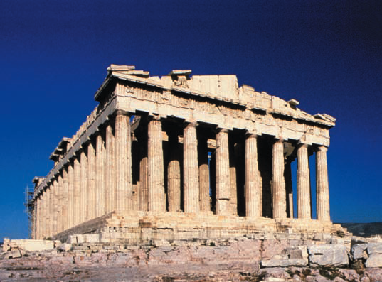
Classicism
Order, objectivity, and proportion
Greece and Rome
European aristocratic sovereigns
  Rule by inherited right
  Louis XIV: absolute monarchy
The Parthenon, Athens (447–438 B.C.E.)
Notes:
In the Classical era, order, reason, and serenity were used to express emotions in the different art forms. The Classicists sought to emulate the qualities of order, stability, and harmonious proportion, which were found in the art and literature of ancient Greek and Rome.
Aristocratic sovereigns continued to rule, enjoying power through inherited right. However, the social upheaval of the French revolution from
1789–99 shifted the power from the aristocracy to the middle class.
The American Revolution (1775–83) broke out before the French Revolution. The trigger was injustices imposed on them by the English king, George II, however, the main issue was that of human equality and freedom. The Industrial Revolution contributed to the wealth of the middle class. Inventions included the improved steam engine, spinning jenny, and cotton gin. Advances in science improved the human condition as well. Benjamin Franklin harnessed electricit,; Joseph Priestly discovered oxygen, and Edward Jenner perfected vaccination.
This era has been called the Age of Reason due to the popularity of the social and political ideas of Voltaire and Rousseau. These philosophers were also advocates of the middle class because equality of man was a main tenet of their philosophy: “Man is born free, and everywhere he is in chains.” —Rousseau
Pictured: The Parthenon, Athens (447–438 B.C.E.). The architecture of ancient Greece embodied the ideals of order and harmonious proportions.

Slide 3
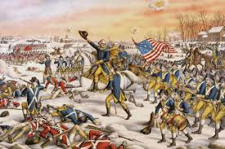

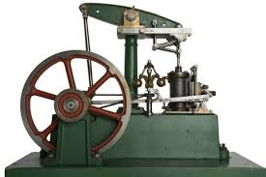
Rise of the middle class
Human equality/freedom
  American Revolution (1775–83)
  French Revolution (1789–99)
Advances in science
  Electricity
  Oxygen
  Vaccinations
Industrial Revolution
  Cotton gin
  Improved steam engine
Age of Reason
  Voltaire
  Rousseau: man is born free, and yet everywhere he is in chains
Notes:
In the Classical era, order, reason, and serenity were used to express emotions in the different art forms. The Classicists sought to emulate the qualities of order, stability, and harmonious proportion, which were found in the art and literature of ancient Greek and Rome.
Aristocratic sovereigns continued to rule, enjoying power through inherited right. However, the social upheaval of the French revolution from
1789–99 shifted the power from the aristocracy to the middle class. s
The American Revolution (1775–83) broke out before the French Revolution. The trigger was injustices imposed on them by the English king, George II, however, the main issue was that of human equality and freedom. The Industrial Revolution contributed to the wealth of the middle class. Inventions included the improved steam engine, spinning jenny, and cotton gin. Advances in science improved the human condition as well. Benjamin Franklin harnessed electricit,; Joseph Priestly discovered oxygen, and Edward Jenner perfected vaccination.
This era has been called the Age of Reason due to the popularity of the social and political ideas of Voltaire and Rousseau. These philosophers were also advocates of the middle class because equality of man was a main tenet of their philosophy: “Man is born free, and everywhere he is in chains.” —Rousseau
Pictured: The Parthenon, Athens (447–438 B.C.E.). The architecture of ancient Greece embodied the ideals of order and harmonious proportions.

Slide 4
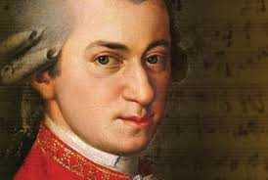
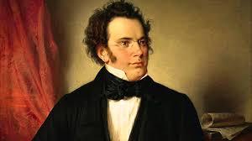
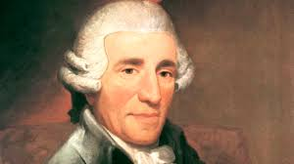
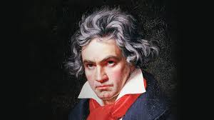
The ‘Viennese’ School
The big three + a latecomer: can you identify?
Haydn (1732-1809)
Mozart (1756-1791)
Beethoven (1770-1827)
Schubert (1797-1828)
Notes:
The Viennese school is a name given to a group of Classical era composers: Haydn, Mozart, and Beethoven. Their music characterizes the Classical Period in music (c. 1750–1825) with lyrical and appealing treatment of melodic and harmonic elements, as well as the development of highly structured instrumental forms.
“Classicism” does not imply that these outstanding composers strictly adhered to the forms that were set into place during this era. They would often depart from them as they desired. With regard to harmonic material, they would often experiment with the possibilities of the major-minor system to the fullest.
One example of such a departure is found in Mozart’s String Quartet No. 19 in C major, K. 465, which was nicknamed “Dissonance” because of its unusually slow introduction.
The ideas of the Viennese school were continued in the work of Franz Schubert.

Slide 5
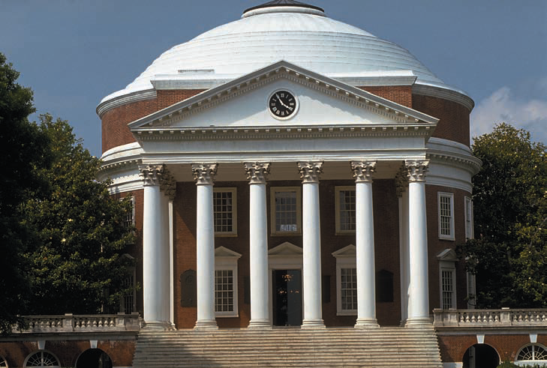
Five elements of Classical Style
Singable, lyrical melody
Diatonic harmony
Regular rhythms and meters
Homophonic texture
(melody with accompanying harmony)
Clarity of structure
The Rotunda of the University of Virginia
Haydn: Trumpet Concerto in E flat, III
Haydn: Symphony No. 94, III (folk elements)
Notes:
Elegant, lyrical melodies characterize the Classical style. Even the instrumental melodies of this era are easy to sing.
Classical melodies are often structured in symmetrical four-bar phrases with clear cadences (or resting points) and tend to move stepwise or by small leaps within a narrow range.
The harmonies are diatonic—built from the seven tones of the major or minor scale. The melody is often set gracefully in a homophonic texture (a melody with an accompanying harmony).
Although designed to cater to aristocratic elegance, the songs, symphonies, concerti, string quartets, and sonatas of the Classical era exhibit the influence of the folk and popular elements present in the surrounding culture.
Musical Examples: Mozart Piano Concerto No. 21, II
Haydn Trumpet Concerto in E flat, III
Haydn Symphony No. 94, III. [link to excerpts]
Pictured: Thomas Jefferson’s design for the Rotunda of the University of Virginia at Charlottesville, completed in 1826, reflects his admiration for classical architecture.

Slide 6
The sonata cycle
  THE GREAT discovery of the classical period!!
  “Great art likes chains. The greater artists have created art within bounds. Or else they created their own chains.”
  The sonata cycle: used for…
    Symphonies
    Sonatas
    String quartets
    Chamber music
    Concertos
Notes:
The great discovery of the classical period.

Slide 7
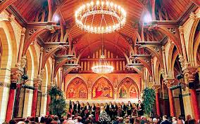

The movements: speed and form
Fast
First movement: _________
  _________ form
Second movement: _________
_________ or _________
Third movement: _________ or ________
  _________ & _________ or _______ & ______
Fourth movement: very _________
  Rondo
Allegro
Slow
ABA
Theme & Variations
Moderate
Moderately fast
Minuet
Trio
Scherzo
Trio
Notes:
I: fast, sonata allegro form
II: slow, theme and variations or ABA
III: medium, dance in triple meter called minuet and trio (ABA form)
IV: very fast, rondo or sonata rondo form

Slide 8
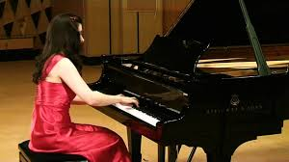
The big picture
Four-movement work: those benefits!
  Length
  Structure
  Blend of new with familiar
  Blend of fast with slow
Composers used 1,000’s of times

Slide 9
The First Movement: Sonata form
Three large sections
  Exposition: main themes introduced
  Development: themes in fragments
  Recapitulation: main themes re-stated

Slide 10
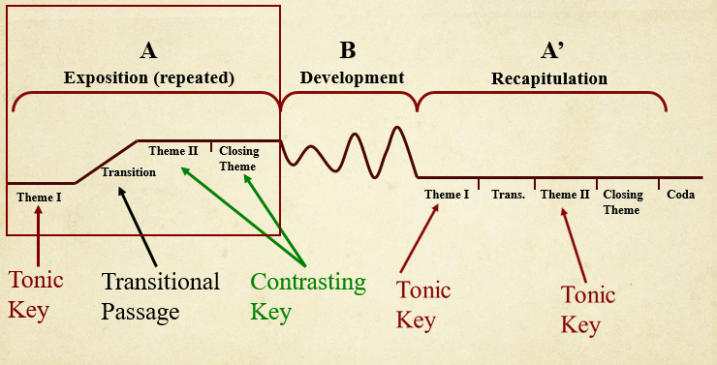
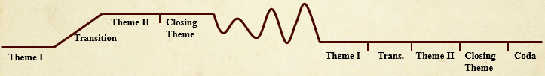
The First Movement: Sonata form
Structure details occurs on two levels
Melody: note that Exposition and Recap are identical except Coda
Tonal plan: note that Expo and Recap are NOT identical
Exposition (repeated)
Development
Recapitulation
Notes:
Sonata-allegro form (also known as sonata form) is one of the most highly organized movements in a multimovement cycle.
There are three main sections in sonata-allegro form/sonata form: exposition, development, and recapitulation.
In the exposition, two themes are presented in contrasting keys. The first theme establishes the home key or tonic; a transitional passage or bridge leads to a second theme in a contrasting key. A closing section with a new theme (sometimes called the closing theme) still in the contrasting key closes out the exposition. In many eighteenth-century cycles, the exposition is repeated.
In the development, one or more of the themes undergo thematic development. Modulation, exchanges of motives, expansion, and contrasting of themes occur in this section.
In the recapitulation, which occurs after the development section, all themes return to the tonic key. The movement will often end with a coda, which is an extension of the final closing theme that leads to the final cadence or resting point in the home key.

Slide 11
Exposition (First Movement)
A
B
A’
Exposition (repeated)
Development
Recapitulation
Theme II
Closing
Theme
Bridge
Theme I
Theme I
Bridge
Theme II
Closing
Theme
Coda
Tonic
Key
Transitional
Passage
Contrasting
Key
Notes:
Here is a diagram of sonata-allegro or sonata form with a breakdown of the exposition. The exposition is often repeated in eighteenth-century works.

Slide 12
Development (First Movement)
A
B
A’
Exposition (repeated)
Development
Recapitulation
Theme II
Closing
Theme
Bridge
Theme I
Theme I
Bridge
Theme II
Closing
Theme
Coda
Musical conflict and action
Harmonically unstable
Thematic fragments
Notes:
Here is a diagram of sonata-allegro or sonata form with a breakdown of the development section, which is characterized by musical conflict and action, frequent modulations, tension, as well thematic and motivic development.

Slide 13
Recapitulation (First Movement)
A
B
A’
Exposition (repeated)
Development
Recapitulation
Theme II
Closing
Theme
Bridge
Theme I
Theme I
Bridge
Theme II
Closing Theme
Coda
Tonic
Key
Tonic
Key!
Closes the entire
movement
Notes:
Play Mozart’s Eine first movement and sing themes: text p.168 CD 2:1
Here is a diagram of sonata-allegro or sonata form with a breakdown of the recapitulation. The reestablishment of the tonic key is a welcome relief after the modulation and intensity of the development section.
The recapitulation follows the general form of the exposition.
A Coda (which means ‘tail’ in Italian) closes the entire movement

Slide 14


Listen to these parts

Slide 15
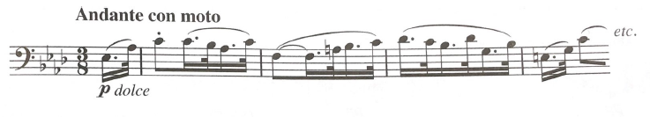
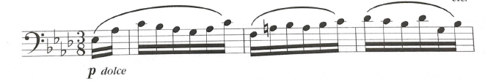
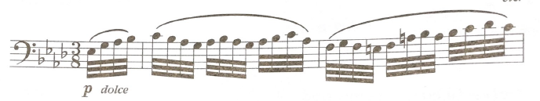
The Second Movement (II)
SLOW: typically an Andante or Adagio tempo
Ternary (A-B-A) form…or…
Theme and variations
Theme
Variation I
Variation II
Notes:
The Second Movement (II) of a multimovement cycle is usually the slow movement—typically an Andante or Adagio in ternary (or A-B-A) form.
Sometimes the second movement would be in a shortened sonata form, or a theme and variations form.
Theme and variations form will be discussed on a later slide.
Here are some examples of second movements from Mozart’s Piano Concerto No. 21 and Beethoven’s Symphony No. 7. [link to excerpt]

Slide 16
Theme and Variations
Theme
Variation I
Variation II
Variation III
a b a b a b a b etc.
Simple form: Theme—Var I—Var II—Var III—Var IV, etc.
So, what kinds of things might be varied??
Key: major to minor, completely new key
Melody: faster, more rhythmic, octave higher
Harmony: more chromatic
Rhythm: from even to dotted
Also: Meter, texture, dynamics, and timbre
Notes:
In theme and variations form, the theme is stated, followed by a series of structured variations.
Each variation sets forth the idea of the theme in a new way—through melodic, harmonic, or rhythmic variation.
Variations on the theme may also be accomplished by changing meter, texture, dynamics, and timbre.
Here is a link to variations on the tune “Greensleeves” [link to excerpt]

Slide 17
The Third Movement (III)
Minuet & Trio or… Scherzo & Trio
Minuet tempo = moderate
Scherzo tempo = fast (too fast to dance!)
A
B
A
Minuet
Trio
Minuet
|| a b || c d || a b ||
Dance I
(no repeats)
Dance I
Dance II
(fewer instruments)
Notes:
In a Classical symphony or string quartet, the third movement is almost always a minuet and trio
A minuet was a stately Baroque court dance in triple meter. The trio was a different minuet played by fewer instruments (usually three)- thus quieter in nature than the 1st minuet.
With regard to form, the overall structure is Minuet (A) Trio (B) Minuet (A)
The Minuet and Trio sections are each in a binary (two part) or rounded binary form.

Slide 18
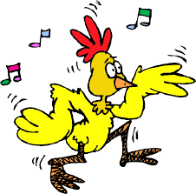
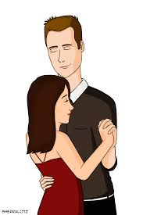
Scherzo (joke)
Sped up version of the Minuet-trio-minuet
  Exact same form as the M-T-M
    Scherzo-trio-scherzo = M-T-M in form
  Much faster pace and rhythmic drive
  Not danceable
  First introduced by Beethoven
  Sometimes replaces M-T-M as third movement
Danceable minuet
NOT danceable scherzo
Notes:
In the nineteenth century the minuet is replaced by a scherzo.
Scherzo is from the Italian word for “joke.” It is in triple meter and three-part form (scherzo-trio-scherzo) that resembles the form of a minuet with a faster pace and more rhythmic drive.

Slide 19

The Fourth Movement (IV)
Rondo…its formal structure:
A-B-A-B-A, or A-B-A-C-A, or A-B-A-C-A-B-A
Mozart’s Eine Kleine 4th mvt Rondo:
A B A C A D A Coda
Notes:
Multimovement cycles in the Classical era often ended with another sonata-allegro form (as previously discussed) or a rondo.
A rondo is based on the recurrence of a catchy musical refrain or idea known as the rondo theme, which is labeled as A in this diagram of possible rondo structure.

Slide 20
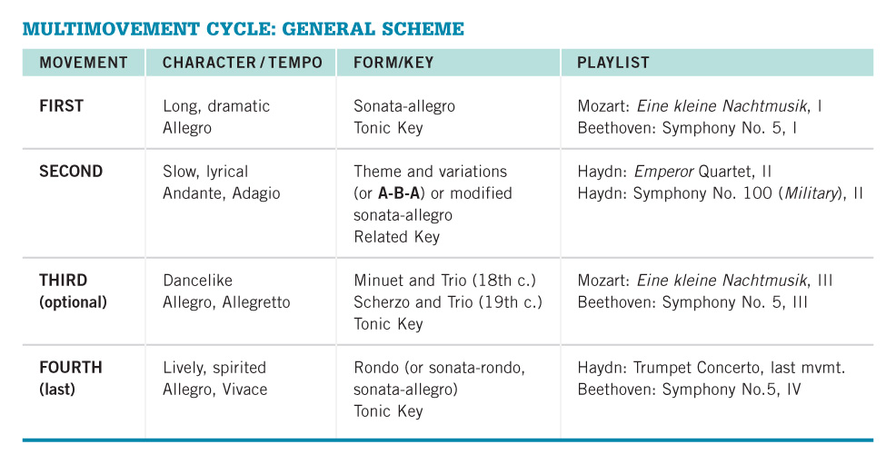
The Multimovement Cycle as a Whole
Notes:
The multimovement cycle of the Classical era was the form employed for many of the most important musical works, including symphonies, sonatas, string quartets, concertos, and other types of chamber music.
This outline sums up the most common practices with regard to form in the cycle.
(Paste general scheme as text for slide p. 161 shorter as graphic)

Slide 21

Looking ahead
  Due today: Opera Activity Assignment due (Extra credit for 10 pts!!)
  Oct 2: Music Department Showcase
    Counts as one of four required concerts
    Complete e-form plus scan of program
  Next class:
    Quiz #5 (ch. 22-25)
    The Classical four-movement forms
        Mozart Eine Kleine Nachtmusik
        Beethoven Symphony #5

